Slide 1
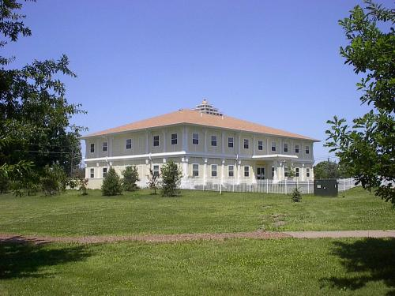
CS401 Modern Programming Practices (MPP) Professor Paul Corazza
MAHARISHI UNIVERSITY of MANAGEMENT
Engaging the Managing Intelligence of Nature
Computer Science Department

Slide 2
© 2015 Maharishi University of Management, Fairfield, Iowa
All rights reserved. No part of this slide presentation may be reproduced or utilized in any form or by any means, electronic or mechanical, including photocopying or recording, or by any information storage and retrieval system, without permission in writing from Maharishi University of Management.

Slide 3
Lecture 2: Associations, Modeling Relationships with UML
Diversifying Self-Referral Relationship
to the World of Objects

Slide 4
Wholeness Statement
In the real world, objects have relationships. These manifested relationships appear in many different ways. In this lecture, we explore the range of relationships that can be modeled in UML depending on how the objects’ relate to each other.
At the most fundamental level every object is made out of the same essence – and is therefore (in a way) related to everything. An intellectual analysis or model of all these relationships is generally not practical.
A direct experience of the underlying reality of all of manifest creation and our relationship with all of nature is a result of our practice of Transcendental Meditation.

Slide 5
Association Analysis
Finding the relationships between concepts

Slide 6
Associations
Define how classes interrelate to each other.
Look at the problem statement after defining the data dictionary and identify verbs (verb phrases)
Chose structural relationship.
Ignore actions and behaviors (transient).
Methods
Verb phrase analysis
Create association matrix

Slide 7
Associations between Classes
Associations
Aggregation / Composition
Inheritance
Use verb phrases in requirements to help identify associations, ignoring those that represent transient actions or behaviors

Slide 8
The Student Registration System
We have been asked to develop an automated Student Registration System (SRS) for the university. This system will enable students to register online for courses each semester, as well as track their progress toward completion of their degree.
When a student first enrolls at the university, he/she uses the SRS to set forth a plan of study as to which courses he/she plans on taking to satisfy a particular degree program, and chooses a faculty advisor. The SRS will verify whether or not the proposed plan of study satisfies the requirements of the degree that the student is seeking.
Once a plan of study has been established, then, during the registration period preceding each semester, students are able to view the schedule of classes online, and choose whichever classes they wish to attend, indicating the preferred section (day of the week and time of day) if the class is offered by more than one professor. The SRS will verify whether or not the student has satisfied the necessary prerequisites for each requested course by referring to the student’s online transcript of courses completed and grades received (the student may review his/her transcript online at any time).
Assuming that (a) the prerequisites for the requested course(s) are satisfied, (b) the course(s) meet(s) one of the student’s plan of study requirements, and (c) there is room available in each of the class(es), the student is enrolled in the class(es).
If (a) and (b) are satisfied, but (c) is not, the student is placed on a first-come, first-served wait list. If a class/section that he/she was previously waitlisted for becomes available (either because some other student has dropped the class or because the seating capacity for the class has been increased), the student is automatically enrolled in the waitlisted class, and an email message to that effect is sent to the student. It is the student’s responsibility to drop the class if it is no longer desired; otherwise, he/she will be billed for the course.
Students may drop a class up to the end of the first week of the semester in which the class is being taught.

Slide 9
Association Matrix
 | Section | Course | Plan of Study | Professor | Student | Transcript
Section
Course
Plan of Study
Professor
Student
Transcript

Slide 10
Associations– In class Exercise
In your small groups refer to our problem description and fill in the Association Matrix for our classes.

Slide 11
 | Section | Course | Plan of Study | Professor | Student | Transcript
Section |  | instance of |  | is taught by |  | included in
Course |  | prerequisite for | is called for by
Plan of Study |  | calls for |  |  | observed by
Professor | teaches |  |  |  | advises; teaches
Student | registered for; waitlisted for; has previously taken | plans to take | observes | is advised by; studies under |  | owns
Transcript | Includes? | Includes? |  |  | belongs to

Slide 12
Problem Description – In class Exercise
In your small group now try to create a diagram with all the classes and their labeled associations

Slide 13
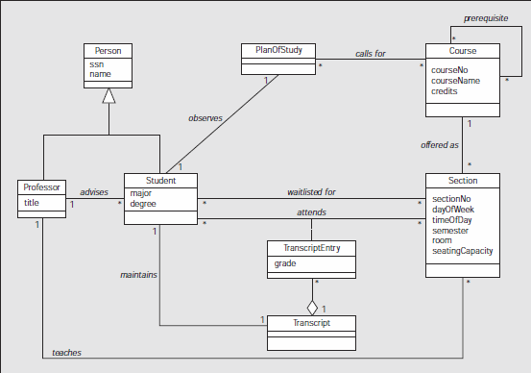
Student Registration System

Slide 14
Main Point 1
Building a software system using OO principles involves an analysis step in which the problem is analyzed and broken into pieces as objects are discovered. The pieces are then refined and put together -- in a step of synthesis – to give a picture of a unified system. This step of synthesis happens through the identification of relationships between classes, represented by associations. This phenomenon is a characteristic of all knowledge – it arises through a combination of analysis and synthesis.

Slide 15
Modeling Associations
Connecting the parts into a wholeness

Slide 16
Topics:
Association
Multiplicity
Aggregation
Composition
Inheritance
Navigation
Roles
Association Classes
Reflexive Associations

Slide 17
Describing Relationships
Relationships define how objects interact:
Student takes Sections
Professor teaches Sections
Client pays Vendor
Customer places Order
Relationships are often two-way streets:
Student takes Section
Section is taken by Student

Slide 18
Association
Unidirectional
Objects of a class have a reference to an object of another class.
Associations as attributes.
Name that describes the association
Customer
places
Order
1
public class Customer {
private Order order;
}
public class Order {
}
//does this look right to you?

Slide 19
Association
Bi-directional
Description direction is more important (still optional)
Customer
places
Order
1
1
public class Customer {
private Order order;
}
//now does this look right?
public class Order {
private Customer customer;
}

Slide 20
Association
A customer should be able to have more than one order outstanding …..
Customer
places
Order
1
1
public class Customer {
private Order order;
}
public class Order {
private Customer customer;
}

Slide 21
Association
1 one (mandatory)
three (exactly)
* many
0..* zero or more (optional)
1..* one or more
0..1 zero or one (optional)
Multiplicity
Customer
places
Order
1
0..*
public class Customer {
//private Order order;
//what will our code for
// multiple order be?
}
public class Order {
private Customer customer;
}

Slide 22
Association
1 one (mandatory)
three (exactly)
* many
0..* zero or more (optional)
1..* one or more
0..1 zero or one (optional)
Multiplicity
Customer
places
Order
1
0..*
public class Customer {
private List<Order> orders;
}
public class Order {
private Customer customer;
}

Slide 23
Multiplicity
How many instances of each object must/may be associated with the other?
Optionality
Is the association required?
Cardinality
How many associations are needed?
UML combines both ideas in the Multiplicity concept.

Slide 24
Association roles
Add a description to one, or both sides of the association to indicate the role(s) each object plays in the relationship.
Student
Faculty
advises
+advisees
+ advisor
public class Student {
private Faculty advisor;
}
public class Faculty {
private List<Student> advisees;
}

Slide 25
Main Point 2
Associations model the relationships that can exist between concepts. Simple associations are modeled using an arrow.
The arrow can have a name for ease of reading, and additional symbols to indicate direction and multiplicity.
The ends of an association arrow can also specify an association role, which is a different name for the connecting concept that is used in the context of this relationship.
The simplest state of awareness can also be modeled with an arrow from itself to itself.

Slide 26
Mid-Term Prep Exercise (3-1)
For the following problem statement work independently for 10 minutes to create the class diagram. Try to show the associations you need.
Then review your diagrams for 10 minutes with your small group.

Slide 27
In Class Mid-Term Practice
A Human Resource (HR) department keeps track of employees for several companies. Each company has a name and may consist of many departments. A department has a name and a location. Each department has one or more positions. A position may be vacant. Otherwise, an employee is assigned to it. The HR personnel enter an employee’s first name, middle initial, last name, birth date and Social Security Number (SSN). An employee also has a unique employee Id and a salary. A position has a title and a short description.

Slide 28
Aggregation
Represents a ‘whole-part’ relationship
‘contain’
‘is part of’
Code looks the same as an association.
Association name is implied
public class Department {
private List<Student> students;
}
public class Student {
private Department department;
}

Slide 29
Composition
Strong aggregation
‘whole-part’ relationship
Parts ‘live-and-die’ with the whole.
Code impacts?
Company
Department
1
0..*

Slide 30
Composition
Code impacts? Will likely be in the logic for how we construct a department and what happens when a company is deleted.
Company
Department
1
0..*

Slide 31
Reflexive Association
Relationship between two or more objects of the same class.
Association role
+prerequisites
0..*
Course
What will the code be?

Slide 32
Reflexive Association
Relationship between two or more objects of the same class.
Association role
+prerequisites
0..*
Course
public class Course {
private List<Course> prerequisites;
}

Slide 33
Association Classes
Association Classes are useful to contain attributes of the link between objects.
These are often modeled this way during analysis
Student
attends
Section
*
*
GradeReceived
grade: String

Slide 34
Association Class - reworked
Student
attends
Section
*
*
GradeReceived
grade: String
During design, association classes are often re-worked to reflect the code instead of the concepts
Student
Section
gets
GradeReceived
issues
1
*
grade: String
*
1
attends

Slide 35
Main Point 3
There are several special forms of association, such as reflexive associations, aggregation, composition, and association classes.
Although most of these have their own symbols, you could still model these relationships without them.
The use of the symbols is to (easily) communicate additional information about the relationship.
Nevertheless, even these additional symbols are still based on the simple concept of an arrow. This is an example of diversity on the basis of unity.

Slide 36
Mid-Term Prep Exercise (3-2)
Objective: understand reflexive associations
Task: Draw a UML class diagram for each of the following problem statements.
1. Doubly-Linked List:
A LinkedList consists of zero or more ListItems. However, the LinkedList
class only knows about the first ListItem. Each ListItem knows its previous
and its next ListItem, if any.
2. Position Hierarchy:
A position may or may not be a managerial position. If it is a managerial
position, then other positions report to this one.
3. Course Prerequisites:
A university course may or may not require the student to have taken other courses first before taking this one. Any course can be a prerequisite course for any other course, except for itself.

Slide 37
Summary
Today we looked at modeling associations:
We can use an association matrix to analyze what the relations are between concepts
Associations are modeled with a line, a name describing the association, numbers on each side to indicate multiplicity, and optionally an arrow for directionality
Reflexive associations, aggregation, composition, and association classes are further model refinements of associations.

Slide 38
Connecting the Parts of Knowledge With the Wholeness of Knowledge
Class diagrams are defined in terms of classes and their relationships (associations)
Although there are various special association forms (composition, aggregation, etc.), all are variations of the fundamental concept of an association from one object to another.
Transcendental consciouness is related to itself through its own self-referral dynamics.
Wholeness moving within itself: In Unity Consciousness, one recognizes that the relationship of the Self to the Self is not only fundamental, but is in reality the only relationship there is.

